Slide 1
Transmit beam-pattern synthesis
Waveform design for active sensing
Chapters 13 – 14

Slide 2
Introduction
Problem
Receive beampattern === transmitt beampattern
(technical issues !! )
MIMO radar
Notes:
Issues : low PAPR – cheap ADCs
MIMO radar: the waveforms can be chose at will.

Slide 3
Beam-pattern to covariance
Signal at target:
Power at a specific .
Notes:
”Narrowband”
Theta is called the probing point - - - P is the transmit beampattern.

Slide 4
The transmit beampattern can be designed by chosing R.
( Individual radiator)
The power constraint
( Total Power )

Slide 5
Goals:
Match a transmit beam pattern.
Minimize cross correlation between probing signals.
Minimize sidelobe level.
Achieve a required main-bem bandwidth.
For a MIMO radar with K targets.
A correlated scattered signal will create ambiguities!!

Slide 6
How to design the signal x knowing R ?
When the covariance matrix of w is the identity matrix.
Optimal Design
Assume targets of interest

Slide 7
If there is no information on the target locations
Optimize for J
With solution is:
The MIMO radar creates a spacially white signal.

Slide 8
Optimal Design for known target locations
An estimate of is available.
The problem becomes:
However:
is the left eigenvector of

Slide 9
Problems with previous design:
Element power uncontrolled.
Power reaching each target uncontrolled.
No controll in Cross-correlation
Any design with phase shifted array will have coherent target scattering.
Advantage :
The same approach maximizes SINR. (different B)

Slide 10
Beam pattern matching design & cross-correlation minimization
Assume a desired beam pattern
A L-targets located at
Are weigths to the cost function.
Allows matching a scaled version of the beampattern.

Slide 11
Previous problem is a SQP
Having r the vector of R_{mm} and R_{mp}
This can be solved using SQP solvers !
Notes:
This problem can be modified to introduce specific levels to the targets.

Slide 12
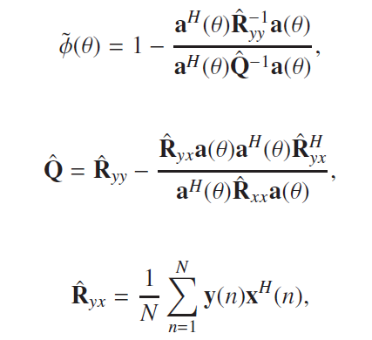
How to obtain ?
Use:
A spatially white signal .
Use the Generalized likelyhood ratio test (GLRT) and/or CAPON.
GLRT, has good features for target detection, jammer avoidance, and trade-off betwen robustness and resolution.

Slide 13
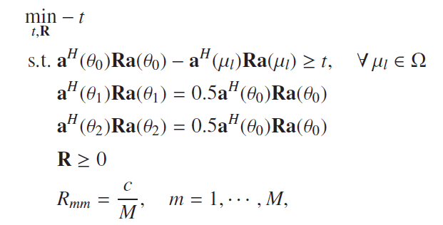
Minimun sidelobe beampattern design
Interestingly a relaxation seems to produce better solution than the strict!

Slide 14
Phase array beampattern
All the radiators contain the same scaled version of the signal x.
Problem becomes non-convex = > hard!!
Introduce a constraint
An approach is to use the same solution as MINO (relaxed version) followed by a Newton-like algorithm.

Slide 15
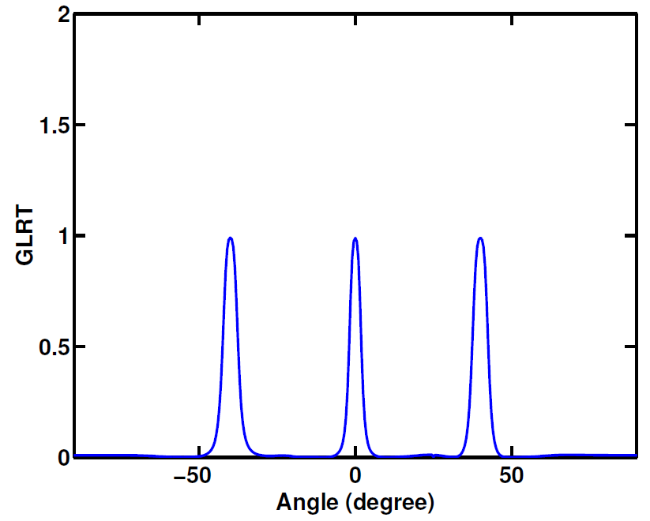
Numerical example
3 targets: 0º, -40º and 40º.
Strong jammer at 25º
Notes:
Strat with a signal that is spatially white……

Slide 16
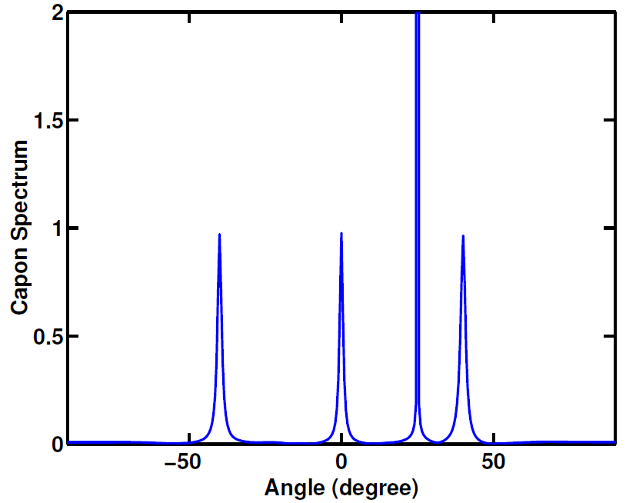
CAPON technique

Slide 17
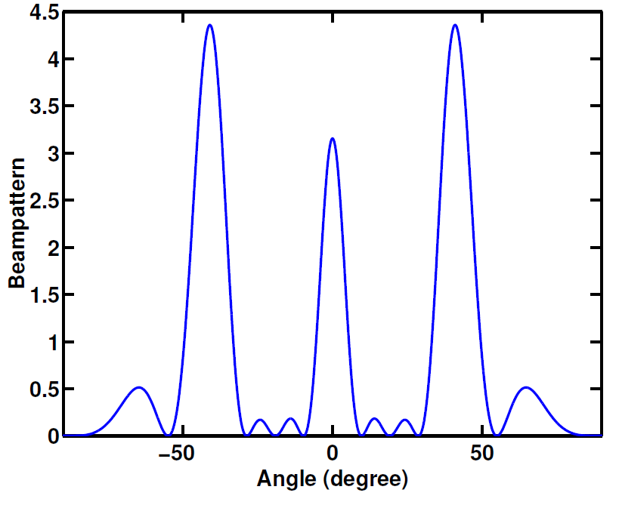
Using = 1 = 0.

Slide 18
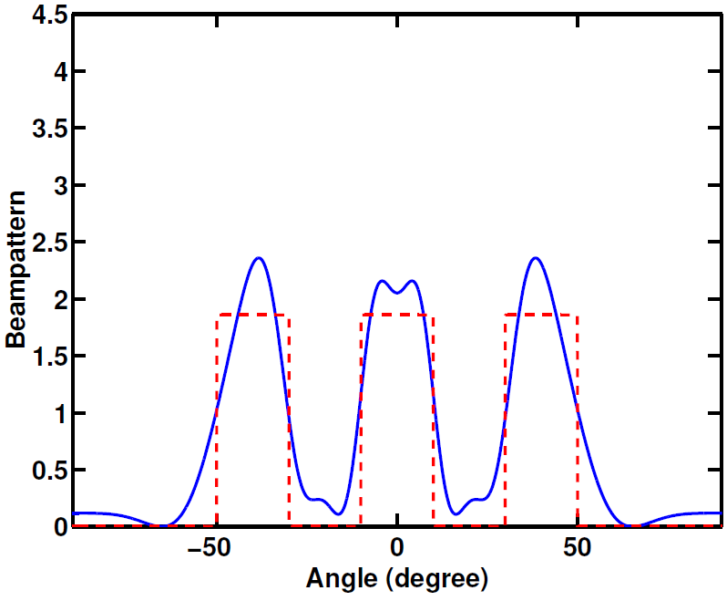
Beampattern design (robust phase)

Slide 19
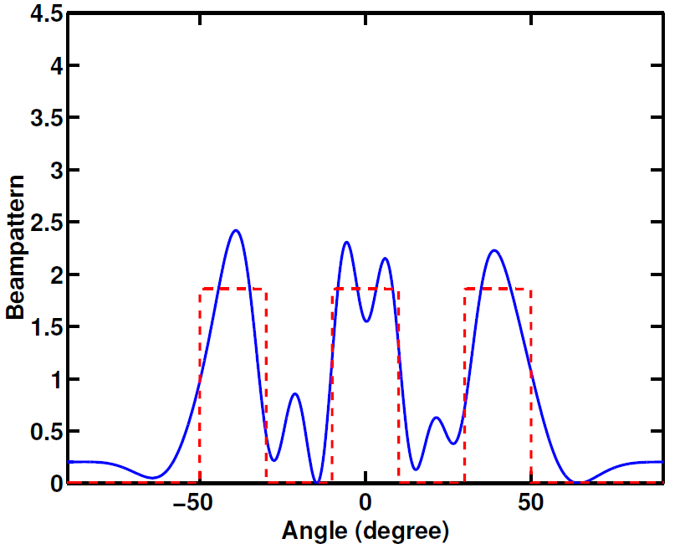
Beampattern design (robust phase)
Using phase shifted array

Slide 20
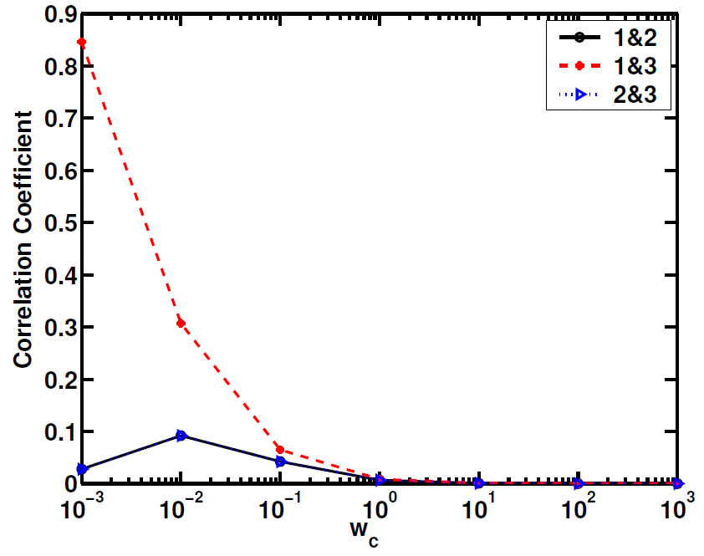
Reducing the cross-correlation

Slide 21
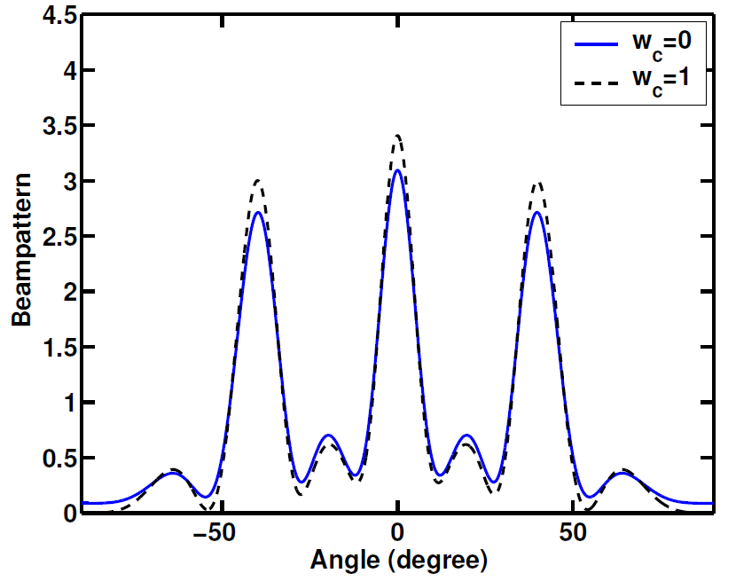

Slide 22
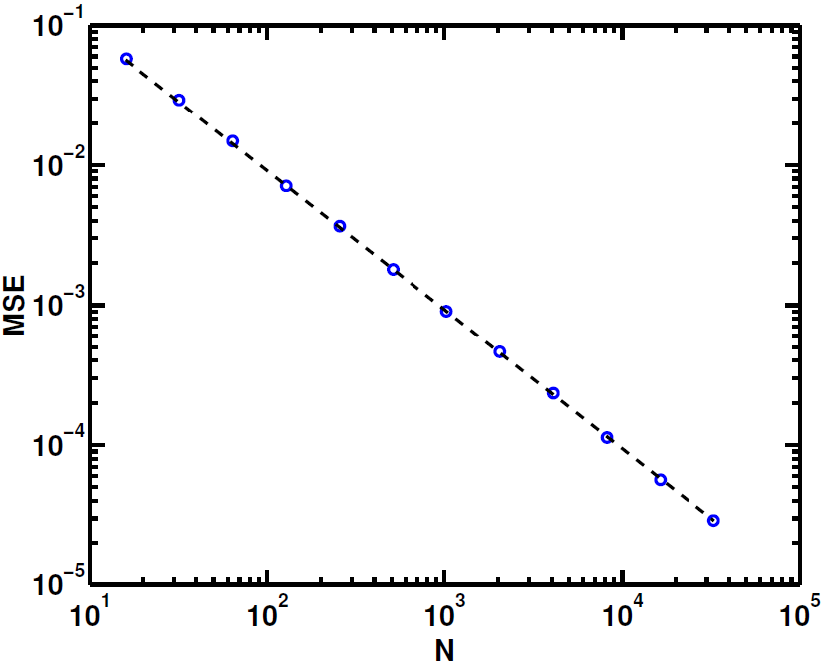
Effect of sample covariance matrix
Having R a design of x ?
The sample covariance of w has to be identity…..
Error
1000
Monte-Carlo

Slide 23
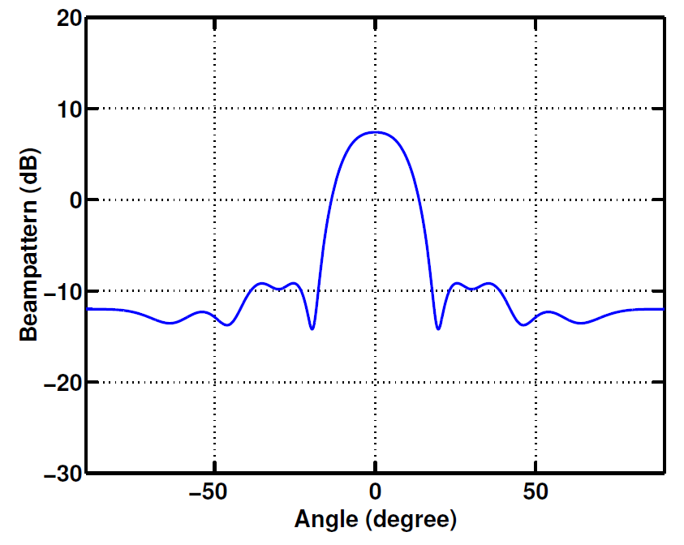
Minimun sidelobe level design
MIMO array

Slide 24
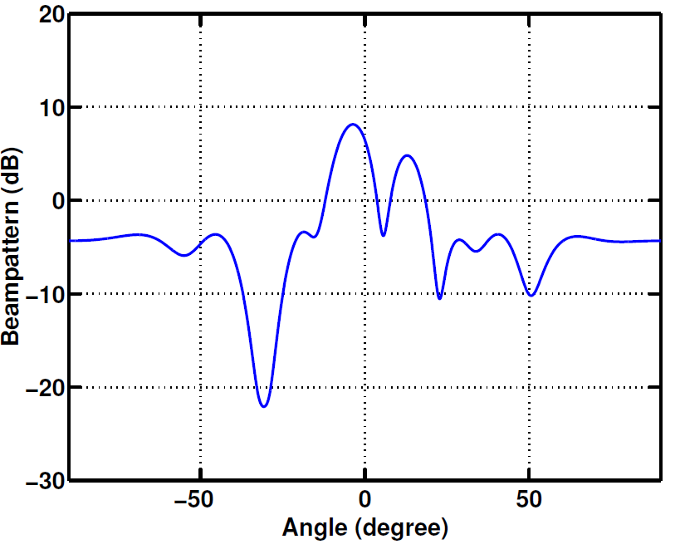
Phase array

Slide 25
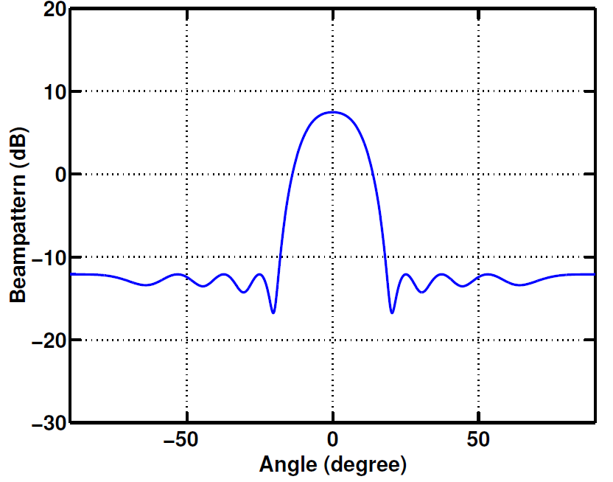
Relax the individual energy constraint from 80% to 120% c/M while the total energy is still fixed.

Slide 26
Covariance to Matrix Wavefrom
The uni-modular constraint can be replaced by a low PAR.
This with a energy constraint will produce:

Slide 27
Assume:
Sample covariance
Result of unconstraint minimization
We need to include good correlation properties:

Slide 28
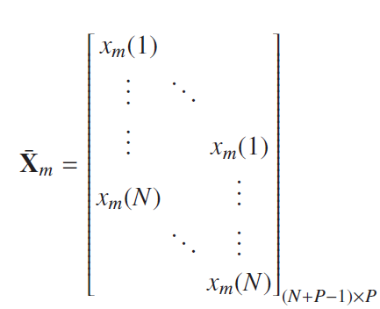
With this notation the goal is:
Using the idea of decomposing X into two matrix multyiplication then we can solve:

Slide 29
Thus:
For unimodular signal design === MultiCAO
replaced
For low PAR constraint ➔ CA algorithm

Slide 30
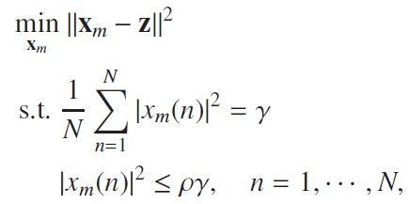
Constraining the PAR becomes the independent minimization problems
With the ”p-th” element of z as:

Slide 31
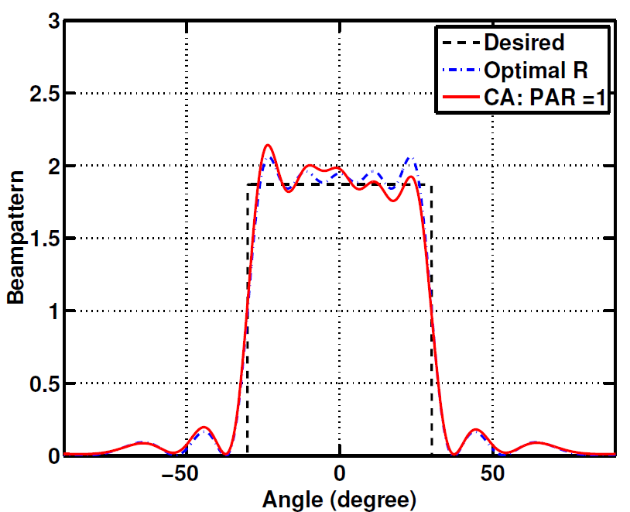
Numerical Results
M=10
P=1
N = 256

Slide 32
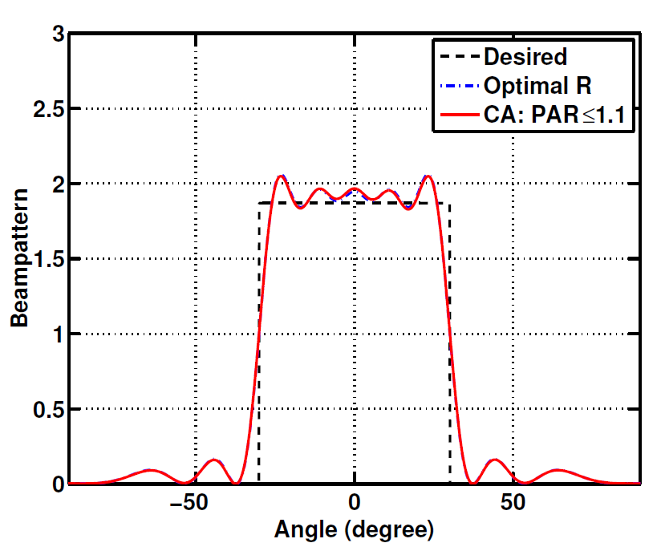

Slide 33
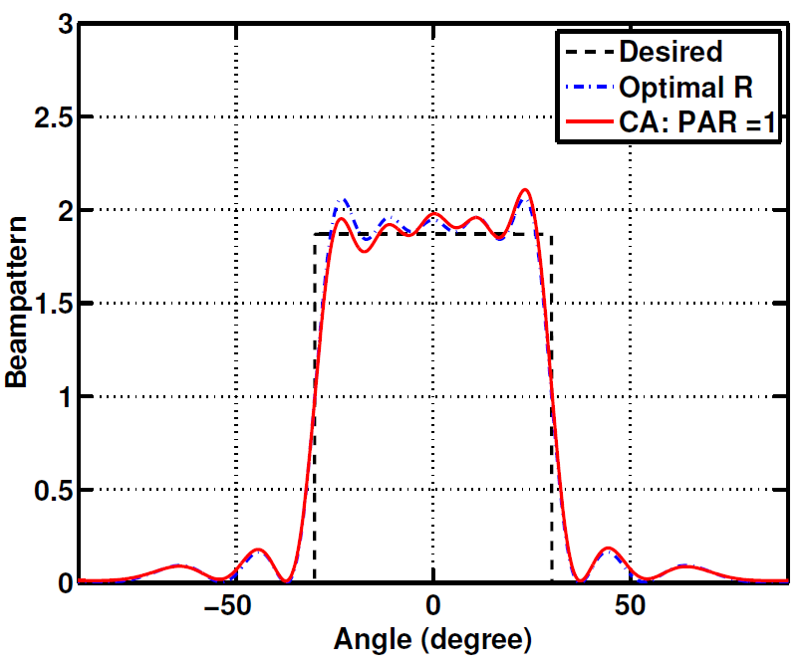
M=10
P=10
N = 256

Slide 34
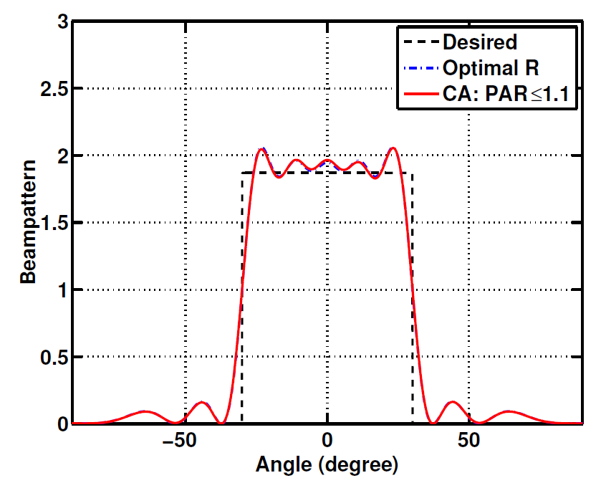

Slide 35
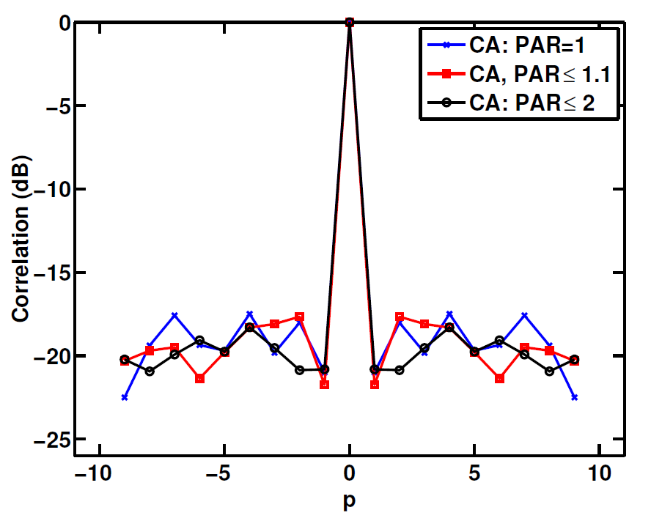
M=10
P=1
N = 256

Slide 36
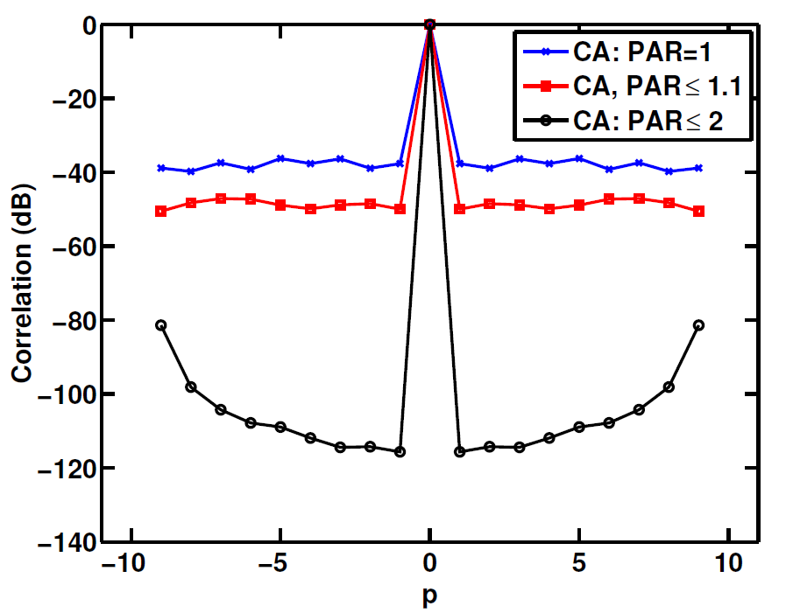
M=10
P=10
N = 256

